Slide 1



Movie Data Analysis
Jesse Heaton, Jonathan Koo, Khyati Thakore

Slide 2
Project overview
What are the characteristics of a successful movie?
Analyzed the top 1,000 grossing movies of all time
Started with a dataset of 16,000 all-time top domestic grossing movies up to 2019
Narrowed the movie data down to the top 1,000
Pulled in additional data from the OMDb API (which limits to 1,000 requests/day)

Slide 3
Does The studio or movie rating affect a movie?

Slide 4
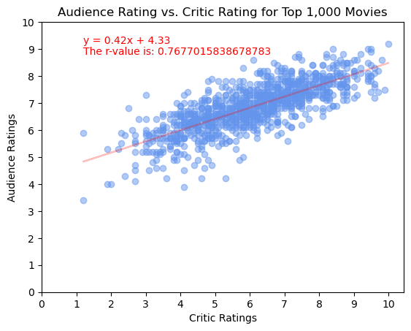
Audience vs. Critic rating
Positive correlation between the watcher rating and the critic rating
Critic ratings are usually lower than watcher ratings
There are only a couple outliers in critic and watcher rating base on the r-value

Slide 5
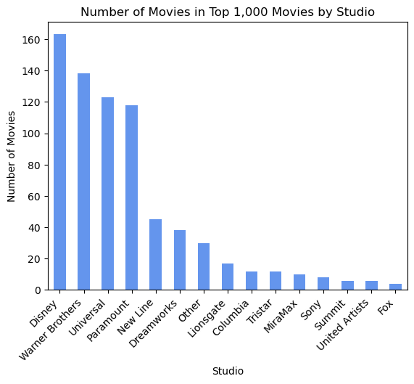
Number of movies in top 1000 movies by studio
Disney has the most movies in the top 1000
Disney, WB, Universal, and Paramount make up over half of the movies in the top 1,000

Slide 6
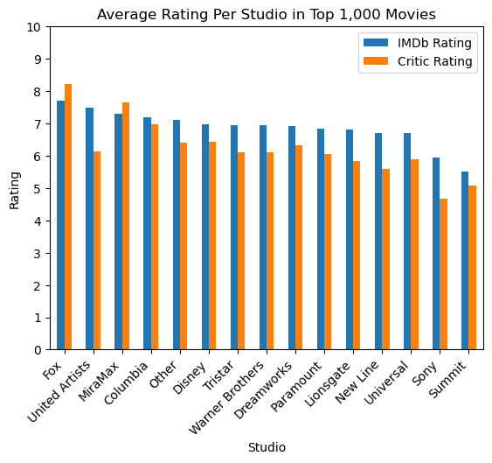
STUDIO VS. rating
Fox is the highest rated production studio
United Artists has the highest difference between watcher and critic rating
User ratings are frequently around 7
Supports the trend that critic rating is usually lower than watcher rating

Slide 7
Does The studio or rating affect a movie?
There are a few studios such as Disney, WB, Universal, and Paramount that have a majority of the top 1,000 movies
Critics usually rate a movie lower than average movie watchers
The rating of a movie does not matter too much since they seem to average out with the more movies by each studio and there are very little outliers

Slide 8
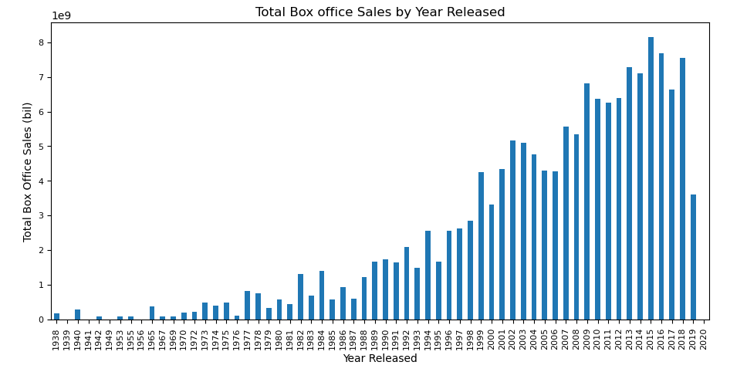
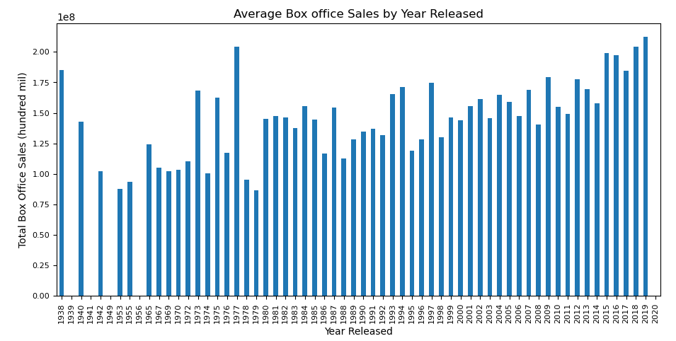
Box office sales by Release date
By Year of Release
Total box office sales generally increased over the years measured
More movies released per year
Average box office sales generally remained constant over the years measured

Slide 9
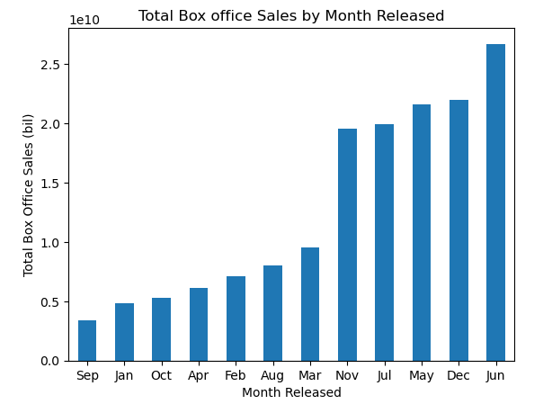
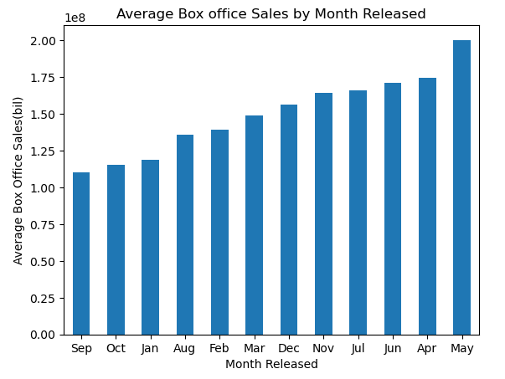
Box office sales by Release date
By Month Released (not in sequential order)
Total box offices sales are greater in the early summer months and holiday months
Average box offices sales are generally greater in those months

Slide 10
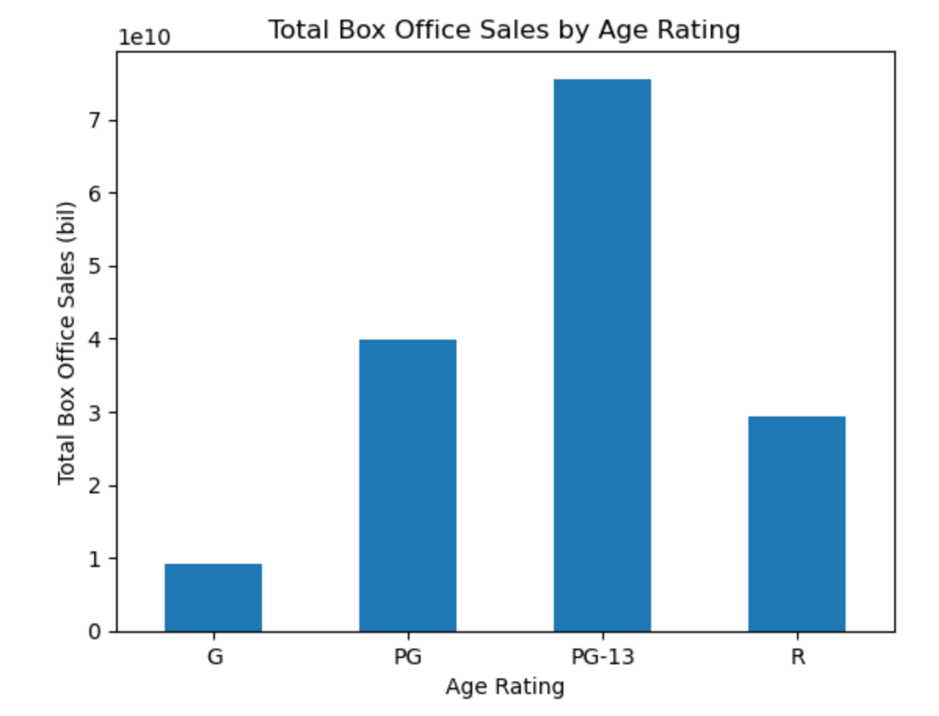
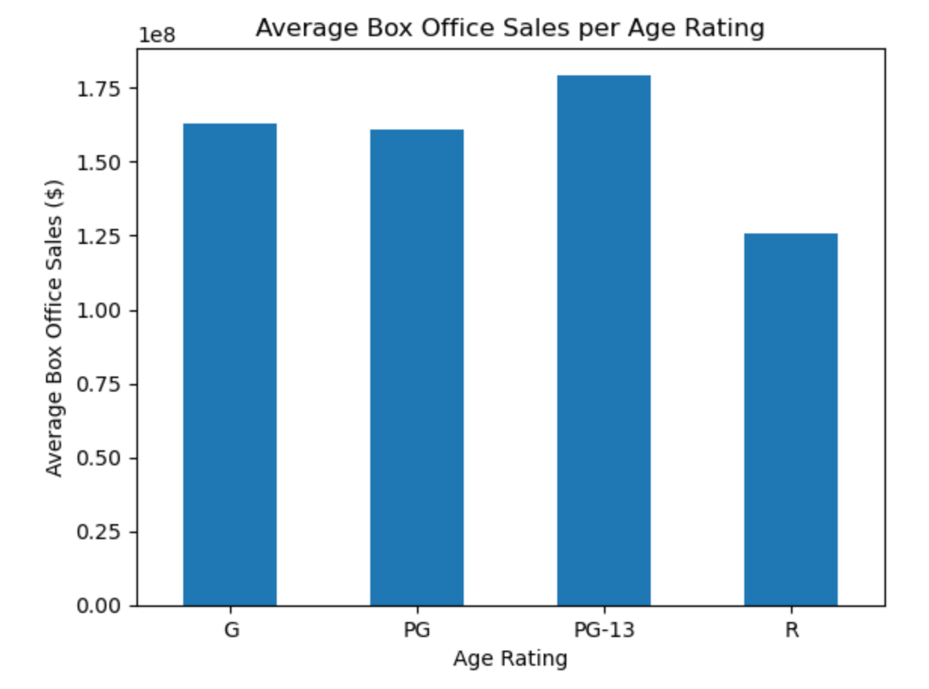
Box office sales by movie (age) rating
Total box office sales are highest for PG-13 category
Also looked at average box office sales to account for more PG-13 movies made
PG-13 still has the highest average box office sales

Slide 11
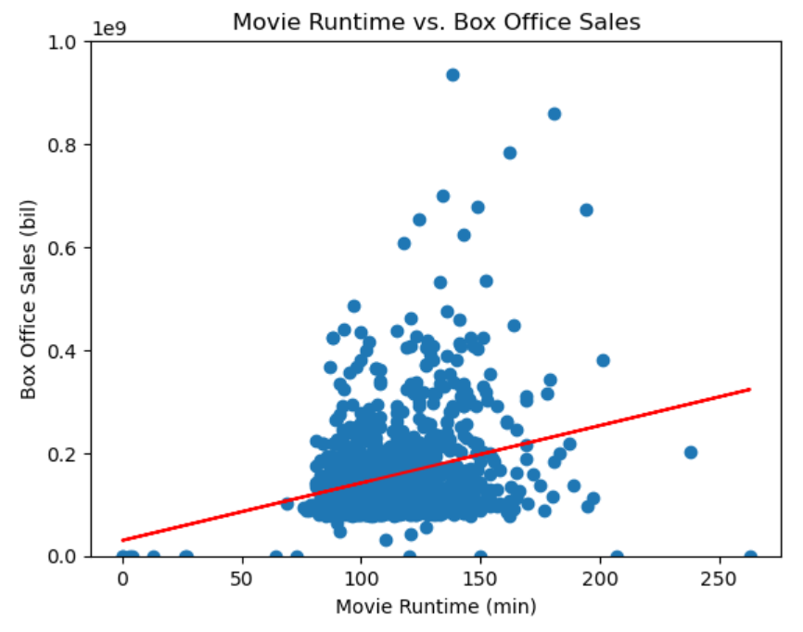
Runtime vs box office sales
The correlation coefficient between movie runtime and box office sales is 0.26.
There is a weak positive correlation between movie runtime and how well they do in the box office.

Slide 12
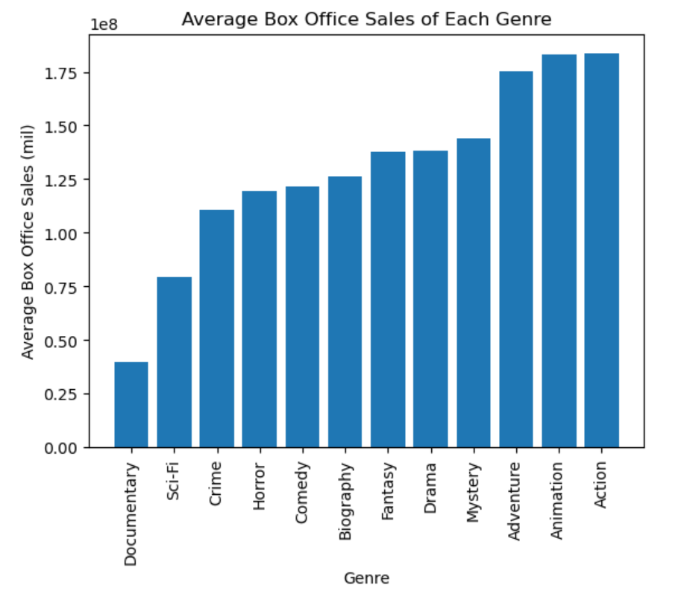
Genre vs box office sales
The most successful movies were under the following genres: Action, Adventure, Animation.
The least successful are documentaries.

Slide 13
Limitations of Data and Analyses
Limitations of API data (1000 calls/day)
The original dataset that we worked with ends at 2019
Not all 1000 movies were found on the OMDb database
Using box office sales and ratings as primary metrics of success
Other more complicated factors that could be analyzed: top actors, awards nominated for/won, directors/producers, budgets, advertising metrics etc.

Slide 14
Improvements for Further Analysis
Increase the size of the sample
Analyze other metrics of success, such as awards
Analyze data for cast/actors
Include global data
Include streaming data or do a separate analysis
Compare other datasets to observe patterns

Slide 15
Conclusion Questions/Comments?

